Slide 1
2024 Rules Interpretation Meeting September 29, 2024 Wade Reid NYSGBOA Rules Interpreter wreid1111@gmail.com

Slide 2
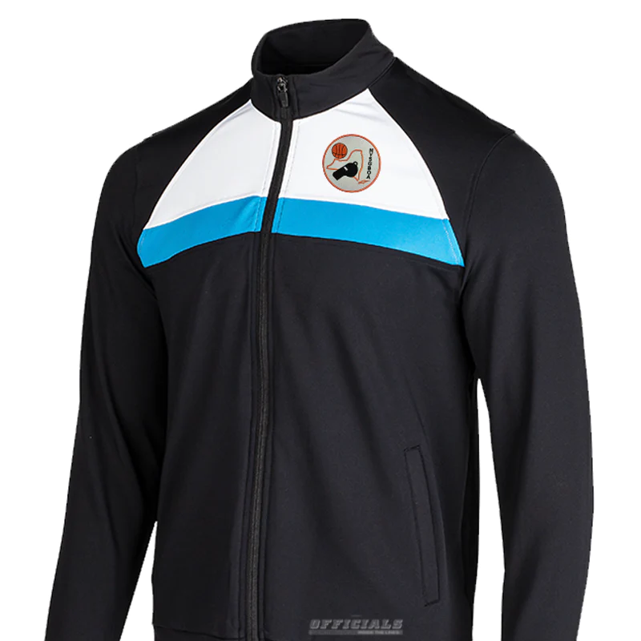

Slide 3
Points of Emphasis
Enforce the Rules as Written
Screening
Traveling
Legal guarding Position
Post Play/Three seconds in the lane
Contact On and By the Ball Handler/Dribbler
Sporting Behavior/Conduct
Clamping

Slide 4
Enforcing the Rules as Written
Officials are tasked with ensuring teams play within the rules. The rules basically guarantee fair play to the end that no player and neither team gains an unfair advantage over an opponent.
When officials do not enforce the playing rules, it impacts the purpose of the playing rules. There is no room for personal philosophies or using “ game management” to ignore enforcing a playing rule.
Let’s be consistent from game to game and it starts in the pregame.

Slide 5
Screening
Knowing what constitutes a legal screen is imperative.
Screeners must establish a legal position without causing contact.
Following a legal screen, a screener is permitted to roll.
Lastly, defenders cannot be permitted to hold, reroute, push screeners or push through legal screens.

Slide 6
Traveling
The pre-dribble travel (lifting and replanting the pivot foot, split-feet, and running start)
The spin move to the basket, the “Euro” step and perimeter shooters taking an extra “hop” just after they receive the ball or just before releasing the try.
Focus on identifying the pivot foot.

Slide 7
Legal Guarding Position
Obtaining an initial legal guarding position on the player with the ball, time and distance are NOT required. Two feet on the floor and torso must be facing the opponent.
Officials must recognize when a defender obtains and maintains legal guarding position to correctly rule on block/charge plays and should not default to a block.
Defenders can move east, west or south. When they step forward or north it would be a block.

Slide 8
Post Play/Three Seconds in the Lane
Once a player has legally obtained their position as a defender on an offensive post player, they can neither displace their opponent nor be displaced.
It does not matter whether the offensive post player is “involved in the play” or not to be in violation of the three second rule.
When this violation is not ruled, the offensive team gains an unfair advantage and increases physically.

Slide 9
Contact On & By the Ball Handler/Dribbler
Illegal contact on the ball handler/dribbler is inhibiting the ability of teams to start their offense.
Measure up or “hot stove” touch is permitted to gauge distance.
Armbars and two hands on the offensive player are AUTOMATIC fouls.
Defenders body contact by body bumping or leaning their torso into the dribbler which affects their rhythm, speed, balance or quickness is a foul.

Slide 10
Sporting Behavior/Conduct
Coach and student-athlete behavior should be consistent with an education environment.
Coaches are expected to stay in their coaching box which extends to the 28-foot line.
Players’ taunting, baiting, finger-pointing, trash talking, and inappropriate gestures shall be penalized with a technical foul.

Slide 11
Clamping
Only new POE this season.
Rebounders grab their opponent, hooking/clamping their arm, to prevent the ability to control the ball.
Clamps often occur while the ball is on its way to the basket.
The player clamping their opponent falls to make it appear they are the one being fouled.

Slide 12
2024-25 Girls HS Rule Modifications
Rule 1-7.1 Three Point Field Goal Line- The three-point field-goal line shall be a distance of 19 feet 9 inches.
Rule 1-8.1 Restricted Area- The restricted area is that area of the playing court located directly underneath each basket. NY State HAS NOT adopted this new rule.
Rule 1-9.1 Coaching Box- The coaching box shall extend from the sideline to the back of the team bench and shall be bounded by the end line extended and not farther than the 28-foot line.

Slide 13
2024-25 Girls HS Rule Modifications Continued
Rule 1-16.2 The Ball- A game may be played with a “non-orange” ball. A pink ball is permissible for Breast Cancer Awareness games.
Rule 1-19.1.2 Shot-Clock Displays- Two visible shot clocks, one at each end of the court. If the shot clocks are not functional, an alternate timing device shall be available when a visible shot clock malfunctions.
Rule 122 Uniforms- 0 & 00 through 99 are legal, a team can’t have both 0 & 00.
Rule 1-25.7 Players Equipment- Hair adornments, which include beads, may be worn provided they are secured tightly to the head and do not pose a safety hazard to the player, teammates or opponents.

Slide 14
2024-2025 Girls HS Rule Modifications Continued
Rule 2-4.2 Officials’ Jurisdiction- All officials shall arrive on the floor 15 minutes before the start of the game and all officials must remain on the floor once jurisdiction begins.
Rule 2-7.9 Officials’ Duties- Use the shot clock to administer the 10-second backcourt count. When the shot clock is not visible, officials shall use the game clock.
Rule 2-11.Art 6.c.2 Duties of Shot-Clock Operator- An intentionally kicked or fisted ball that occurs with 14-seconds or less remaining on the shot clock will reset to 15-seconds.

Slide 15
2024-2025 Girls HS Rule Modifications Continued
Rule 2-11.6.d.2.a Duties of the Shot Clock Operator- The shot clock is reset to 30 seconds when the ball strikes the ring or flange, a change in possession and all fouls. Exception: double fouls which the shot clock time remains.
Rule 4-14.1.2 Faking Being Fouled- Faking being fouled by “flopping” or using a “head bob” to simulate illegal contact. First offense by the team will result in a warning. The second time the team fakes will result in a Team Technical foul.
Rule 5-6.1 Length of Quarters- Playing time for JV and Varsity games shall consist of (4) 8-minute quarters, with 1-minute intermission between 1st and 2nd quarters and 3rd and 4th quarters. 10 minute intermission between 2nd and 3rd quarters.

Slide 16
2024-2025 Girls HS Rule Modifications Continued
Rule 5-9.3,4 Overtime- Overtime shall be 4-minutes in length.
Rule 5-14.9.a Timeouts Granted and Charged- Each team is entitled to (4) full timeouts and (2) 30 second timeouts. If overtime is needed each team is awarded an additional 30 second timeout.
Rule 10-12.3.a.1-5 Team Technical Fouls- A team shall be assessed a team technical foul after a team warning has been issued for each of the delays and faking being fouled. Penalty is two shots awarded to any player of the offended team followed by a throw-in at the division line opposite the scorers’ table.

Slide 17
2024-2025 Girls HS Rule Modifications Continued
Rule 11-1.1 Replay Equipment- Replay equipment or a Courtside monitor will not be used in any NYSPHSAA Girls basketball regular season or playoff contest. In a NYSPHSAA State tournament Semi-Final or Final contest, it shall be used to determine if a last second shot in the 4th quarter or any overtime shall count.
Mechanic change:
Revised 3 second violation signal.

Slide 18
JEWELRY:
Jewelry has been prohibited since 1985.
Rule 1-25.7 (page 30) Under Rule 2-5-1, the referee is responsible for equipment inspection. (page 32).
A bandage or tape may NOT cover jewelry.
Officials are permitted to ask to see what is beneath any bandage or tape; team members who refuse will be prohibited from participating in the contest.
When players have piercings that aren’t visible like a tongue ring, if the official sees the piercing during normal play, they will ask the player to remove or they will NOT be able to continue playing.
Approved ruling 1-22 permits a clear, narrow, pliable plastic stem. These stems are designed to be flexible to reduce the risk of injury. They may NOT be adorned or be any other color than clear.

Slide 19
Faking Being Fouled Mechanic The mechanic for Faking Being Fouled is: Two arms at the shoulder lever, with open palms move the arms downward, pointing toward the floor. This mechanic is used for the warning, as well as the delayed Technical Foul if there is an immediate opportunity to score. Examples to follow……..

Slide 20
Faking Being Fouled Scenario’s A1 driving to the basket to score and B1 “Flops”. Team B has already received a Team warning earlier in the game for faking being fouled. 1- Ignore the “Flop” as A1 wasn’t impeded on her drive to the basket. 2- The official shows the “flopping” mechanic and waits to see the outcome of the immediate drive to the basket before calling a Team Technical Foul. 3- The official calls a Team Technical Foul and kills the play.

Slide 21
Faking Being Fouled Scenario’s A1 driving to the basket to score and B1 “Flops”. Team B has already received a Team warning earlier in the game for faking being fouled. 1- Ignore the “Flop” as A1 wasn’t impeded on her drive to the basket. 2- The official shows the “flopping” mechanic and waits to see the outcome of the immediate drive to the basket before calling a Team Technical Foul. 3- The official calls a Team Technical Foul and kills the play.

Slide 22
Faking Being Fouled Scenario’s A1 driving to the basket and B1 “Flops”, A1 then passes to A5 behind the three-point line. Team B has already received a Team warning earlier in the game for faking being fouled. 1- Ignore the “Flop” as A1 wasn’t impeded on her drive to the basket. 2- The official shows the “flopping” mechanic and waits to see the outcome of the shot before calling a Team Technical Foul. 3- The official shows the “flopping” mechanic and calls a Team Technical Foul once the ball is passed to A5.

Slide 23
Faking Being Fouled Scenario’s A1 driving to the basket and B1 “Flops”, A1 then passes to A5 behind the three-point line. Team B has already received a Team warning earlier in the game for faking being fouled. 1- Ignore the “Flop” as A1 wasn’t impeded on her drive to the basket. 2- The official shows the “flopping” mechanic and waits to see the outcome of the shot before calling a Team Technical Foul. 3- The official shows the “flopping” mechanic and calls a Team Technical Foul once the ball is passed to A5.

Slide 24
Faking Being Fouled Scenario’s A1 is driving to the basket and “Head Bob’s” as if she was being held by B1. Team A has already received a Team warning earlier in the game for faking being fouled. 1- Ignore the incidental contact and allow A1 to continue to the goal. 2- Call a “player/substitute” Technical Foul immediately. 3- Call a Team Technical Foul immediately.

Slide 25
Faking Being Fouled Scenario’s A1 is driving to the basket and “Head Bob’s” as if she was being held by B1. Team A has already received a Team warning earlier in the game for faking being fouled. 1- Ignore the incidental contact and allow A1 to continue to the goal. 2- Call a “player/substitute” Technical Foul immediately. 3- Call a Team Technical Foul immediately.

Slide 26
Faking Being Fouled Scenario’s A1 driving to the basket and B1 “Flops”, A1 misses her layup, gets her own rebound and dribbles back out front to reset her offensive set. Team B has already received a Team warning earlier in the game for “flopping.” 1- Ignore the “Flop” as A1 wasn’t impeded on her drive to the basket. 2- The official shows the “flopping” mechanic and waits to see the outcome of the drive to the basket, once A1 gets the rebound and dribbles the ball out the official calls a Team Technical Foul. 3- The official calls a Team Technical foul and kills the play.

Slide 27
Faking Being Fouled Scenario’s A1 driving to the basket and B1 “Flops”, A1 misses her layup, gets her own rebound and dribbles back out front to reset her offensive set. Team B has already received a Team warning earlier in the game for “flopping.” 1- Ignore the “Flop” as A1 wasn’t impeded on her drive to the basket. 2- The official shows the “flopping” mechanic and waits to see the outcome of the drive to the basket, once A1 gets the rebound and dribbles the ball out the official calls a Team Technical Foul. 3- The official calls a Team Technical foul and kills the play.

Slide 28
Team Technical Fouls: count toward Team totals A team shall be assessed a Team Technical Foul after a team warning has been issued for each infraction: 1-Delaying the game on a throw in, free throw and huddling. 2-Failing to have the court ready for play after the final horn. 3-Breaking the boundary plane by the defense. 4-Interfering with the ball after a goal or failing to immediately pass to the nearest official. 5-Faking being fouled.

Slide 29
Team Technical Fouls: count toward Team totals When the Team Technical Foul is called, it is reported to the table as a Technical foul against Team “A” not A2. The same goes for reporting the warning to the table, it is a warning for Faking Being Fouled by Team “A”. If the coach asks which player it was on, you can advise them of the players number.

Slide 30
Mechanics: Reporting fouls to table When reporting the new range of players numbers which are 0 and 00 up to 99. The challenge is correctly reporting the number to the scorer’s table. *It is imperative that we use a strong loud voice to convey the numbers, coupled with the visual hand mechanic. (#72 is verbalized seventy-two, not seven two).

Slide 31
Layered Plays: A layered play involves a foul or fouls during the live ball period and a foul or fouls during the dead ball period. It is our job to identify what fouls occurred during the live and dead ball periods. We need to determine the order to penalize the fouls.

Slide 32
Layered Plays: A3 drives to the basket, when she goes up to score, she is fouled by B3 and misses. A3 turns around and pushes B3. How is this adjudicated?

Slide 33
Layered Plays: A3 shoots two free throws with no players on the lane line. Any Team B player will shoot two free throws, with no players on the lane line for the intentional foul, followed by Team B awarded the ball at the division line opposite the scorer’s table. A3 is charged with an Intentional Foul. B3 is charged with a Personal Foul.

Slide 34
Layered Plays: A3 drives to the basket, when she goes up to score, she is fouled by B3 and misses the shot. A3 turns around and pushes B3. Followed by B1 pushing A3. How is this adjudicated?

Slide 35
Layered Plays: A3 shoots two free throws with players on the lane line and play resumes from the outcome of the second free throw. The Intentional Fouls by A3 and B1 are fouls of “equal gravity” and cancel each other out. B3 is charged with a Personal Foul. A3 is charged with an Intentional Foul. B1 is charged with an Intentional Foul.

Slide 36
Thank you for your time!!! Good Luck this season…

